Slide 1



Data Visualisation ©
Dr Diarmuid McDonnell & Prof. Vernon Gayle
AQMEN
University of Edinburgh
March 2019
© Diarmuid McDonnell, Vernon Gayle

Slide 2
Welcome
Notes:
Cover the preliminaries:
Timings
Programme
Fire drills

Slide 3
Why are we here today?
U.K. Industrial Strategy aims to utilise big data to improve economic performance and increase productivity.
Major barrier is the lack of a suitably trained workforce.
U.K. social science stakeholders (e.g. ESRC, Nuffield) believe this discipline can make a major contribution to Industrial Strategy.

Slide 4
Why this type of training?
“Many organizations can barely find a way to use their R/Python programmers on reasonable datasets.”
“The piece missing from the data science movement right now is really simple: intelligent application of data science tools.”
https://www.linkedin.com/pulse/data-science-dead-5-years-less-justin-b-dickerson-phd-mba-pstat- accessed 16.07.2018.

Slide 5



Slide 6
What is the social science contribution?
Data Science ≠ Computer Science
Big Data ≈ Small Data
QM Social Scientists = Data Literate

Slide 7
Data Visualisation

Slide 8
In essence
"Graphical excellence is the well-designed presentation of interesting data—a matter of substance, of statistics, and of design … [It] consists of complex ideas communicated with clarity, precision, and efficiency. … [It] is that which gives to the viewer the greatest number of ideas in the shortest time with the least ink in the smallest space … [It] is nearly always multivariate … And graphical excellence requires telling the truth about the data. (Tufte, 1983, p. 51)."

Slide 9

An example
(Cook, 2004)

Slide 10
Why visualise?
Summary statistics can hide important differences between distributions.
Essential aspect of data exploration, and the estimation, reporting and checking of statistical models/analyses.
It’s the zeitgeist.

Slide 11
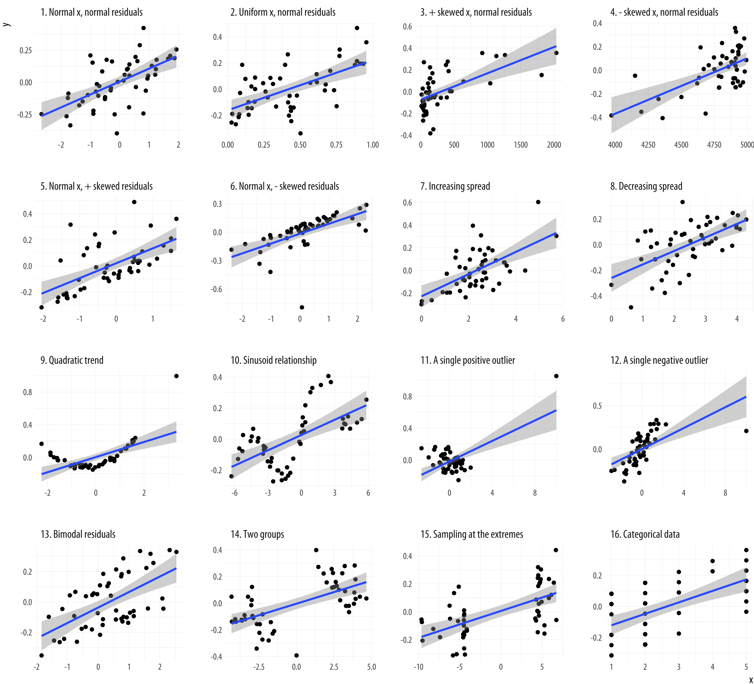

Slide 12
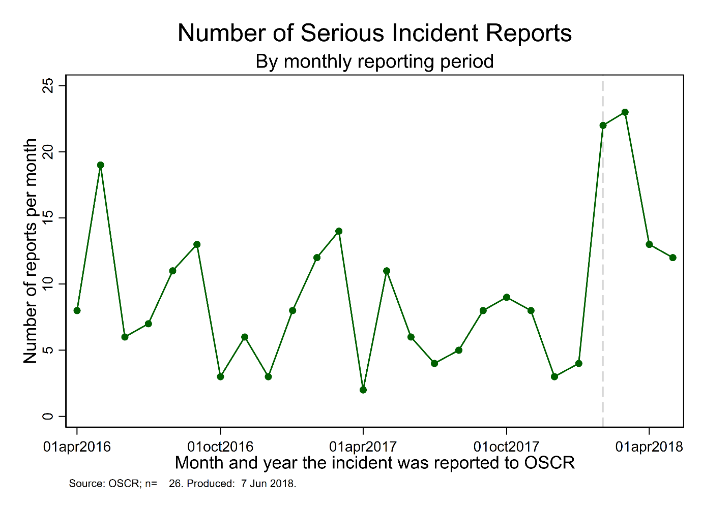
Exploratory Data Analysis

Slide 13
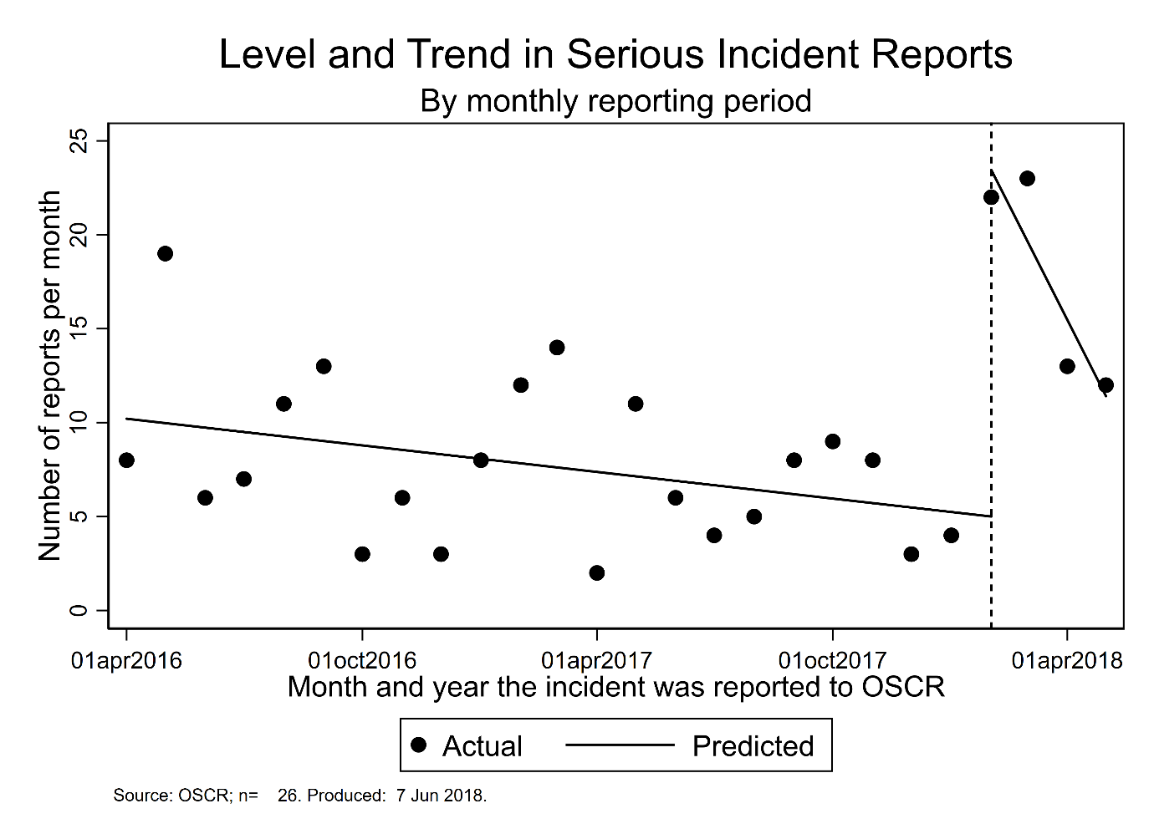
Model Estimation

Slide 14
Model Estimation

Slide 15
Model Checking

Slide 16
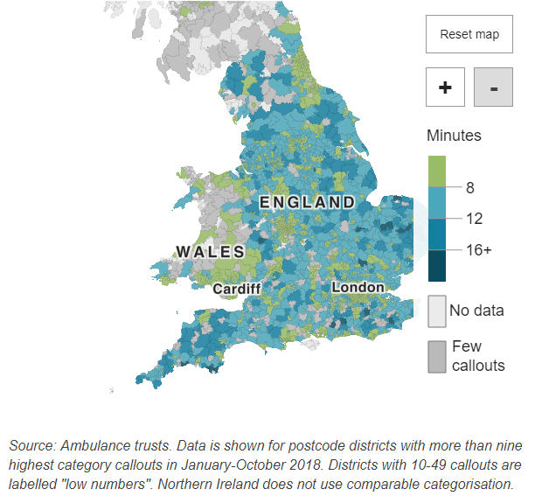
Technique du jour

Slide 17
Definition
The visual representation and presentation of data to facilitate understanding.
Perceive → Interpret → Comprehend
(Kirk, 2016)

Slide 18
Elements of a visualisation
Aesthetic
Substantive
Perceptual
(Healy, 2019)
These elements can be corrupted or disregarded in poor quality data visualisations.

Slide 19

Aesthetic
That is, the arrangement of the visualisation, it’s layout, titles, design, clarity, parsimony, tastefulness etc.

Slide 20
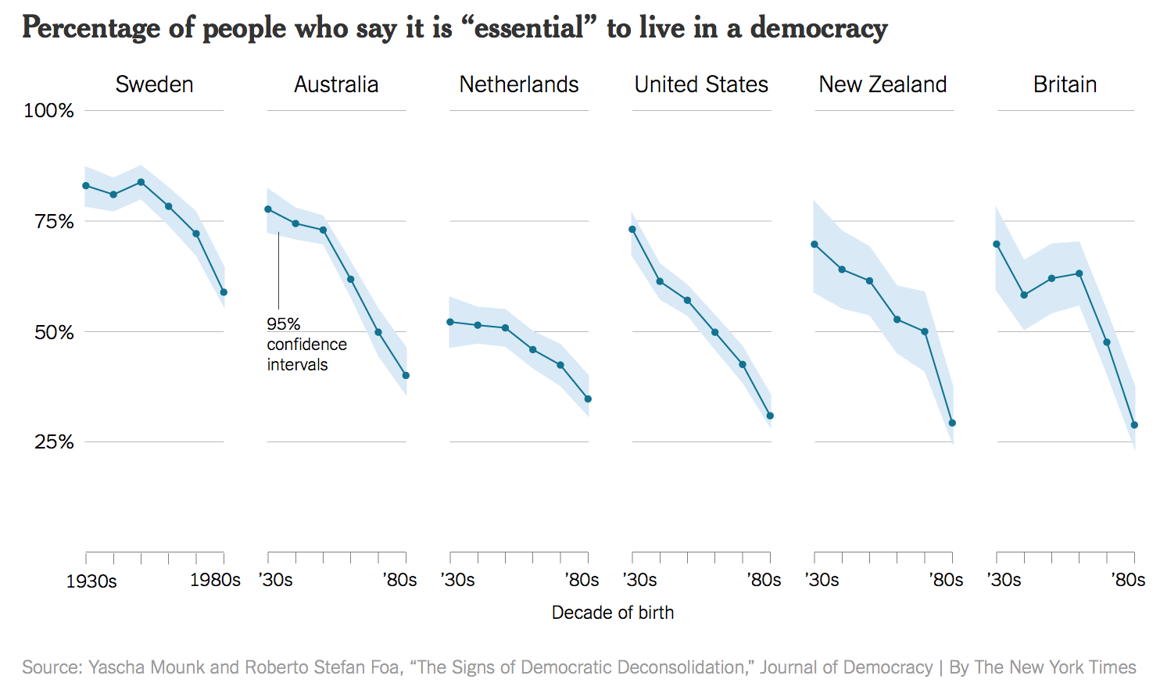
Substantive
That is, the quality of the raw data, the way it was marshalled and analysed, what observations were included and why etc.

Slide 21
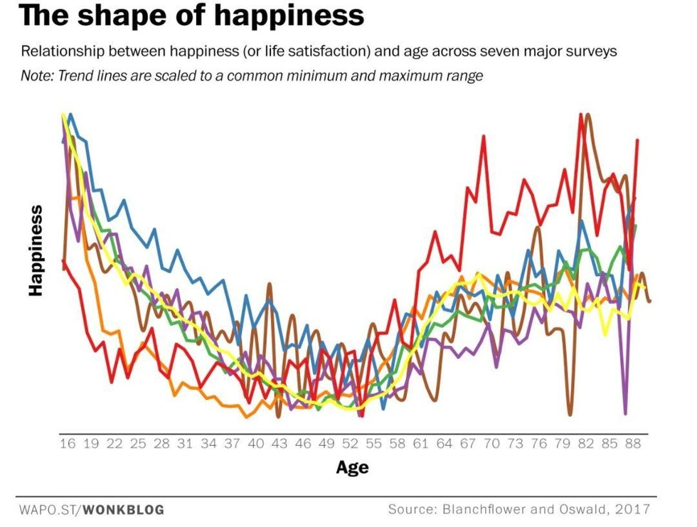
Perceptual
That is, the use of colour, shapes, text size, transparency, lines etc.

Slide 22
What makes a good visualisation?
Principles
Depends on audience and objectives.
Nothing too fancy or clever.
Tells a story but not too affecting.
Doesn’t try to please everyone.
(Speigelhalter, 2016)

Slide 23
What makes a good visualisation?
Practices
No pie charts.
A good table counts as visualisation.
Bar charts are good for conveying the gist of a comparison.
Use words and numbers.
(Speigelhalter, 2016)

Slide 24
The role of trust
Individuals need to be able to intelligently place their trust in your findings.
Visualisations need to demonstrate trustworthiness with regards to their (and your):
Honesty
Reliability
Competence
(O’Neill, 2012)

Slide 25
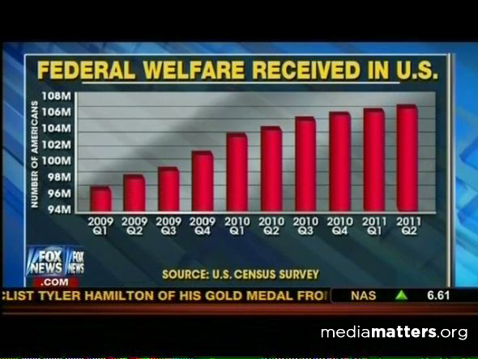
How to be untrustworthy

Slide 26
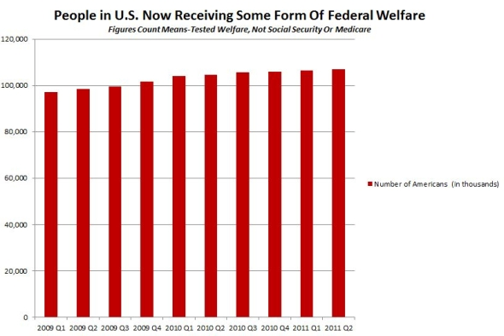
How to be untrustworthy

Slide 27
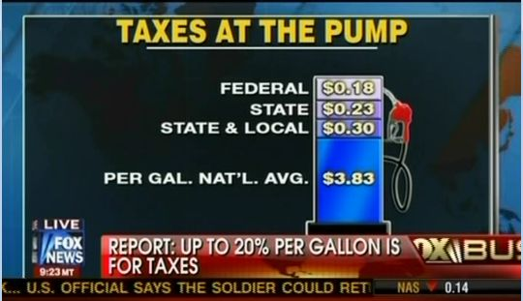
How to be untrustworthy

Slide 28
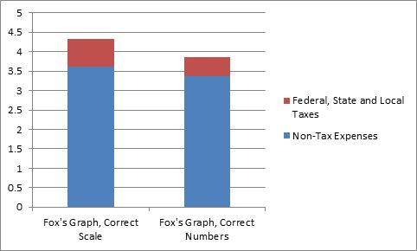
How to be untrustworthy

Slide 29
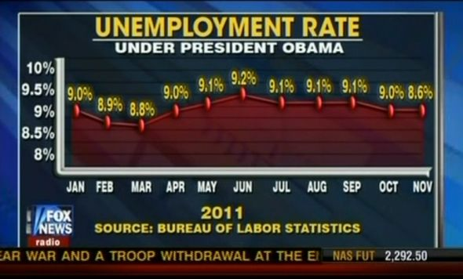
How to be untrustworthy

Slide 30
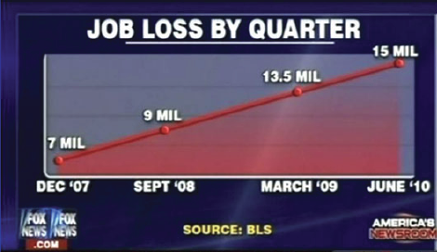
How to be untrustworthy

Slide 31
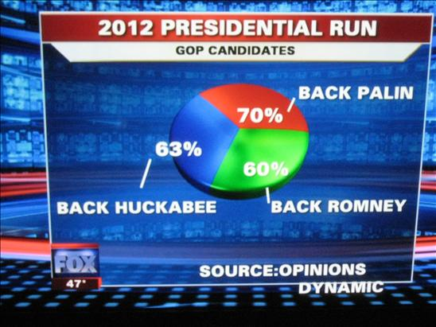
How to be untrustworthy

Slide 32
Visualisation done right
https://flowingdata.com/2013/09/25/the-most-unisex-names-in-us-history/

Slide 33
Workshop

Slide 34
R
Growing in popularity (e.g. data science, statistics, science etc.)
Popular with statisticians
Free (open source)
Difficult to learn
Development and support is not commercial
Help resources are under-developed

Slide 35
Programme
Mix of talks and self-directed practical activities.
Data Visualisation challenge (“Hackathon”).
Tutor and peer support.
Use of a variety of data sets, especially messy administrative records.

Slide 36
Top tips
Ask plenty of questions.
Take your time.
Complete as many of the tasks and exercises, and answer as many of the questions as you can.
Annotate your work.
Be positive.

Slide 37

Estimating Work Time…

Slide 38
Good Luck
Our aim is to equip you, as rapidly and painlessly as possible, with a proficiency in data visualisation using R.
We think it is an ambitious yet achievable goal.
Them: “Are you any good at data visualisation?”
You: “Yes, yes I am.”

